Slide 1



USA Flight data
Project Big Data, Business Intelligence and NoSQL
By
Ishan Ameel
Jonas Anseel
Thomas Billiet
Sven Depickere

Slide 2


Cleanup

Slide 3
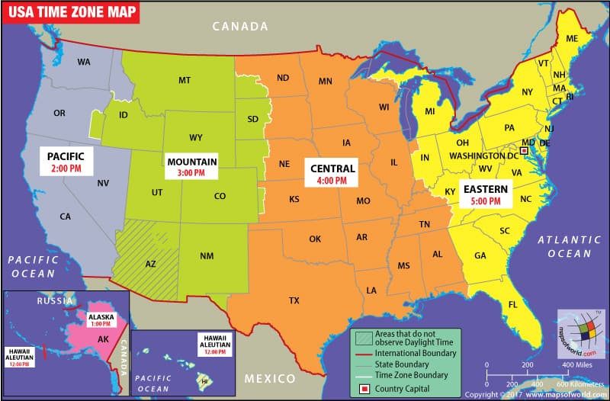
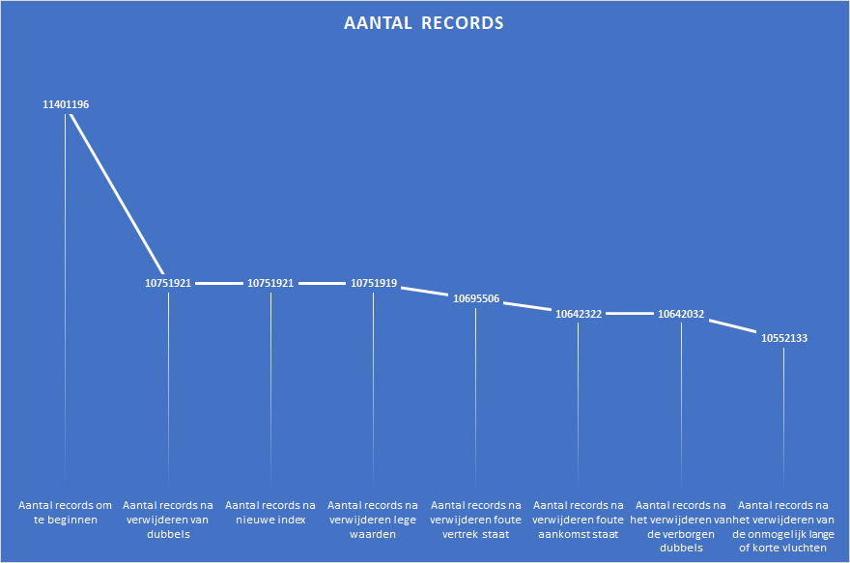

Slide 4

Charts

Slide 5
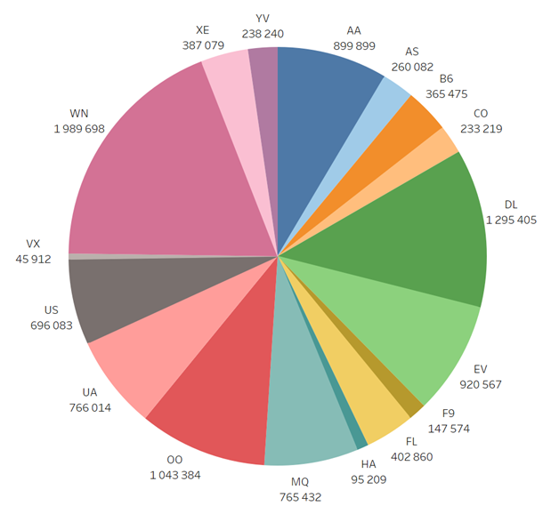
How many flights are being served by which carrier from 2011 to 2012

Slide 6
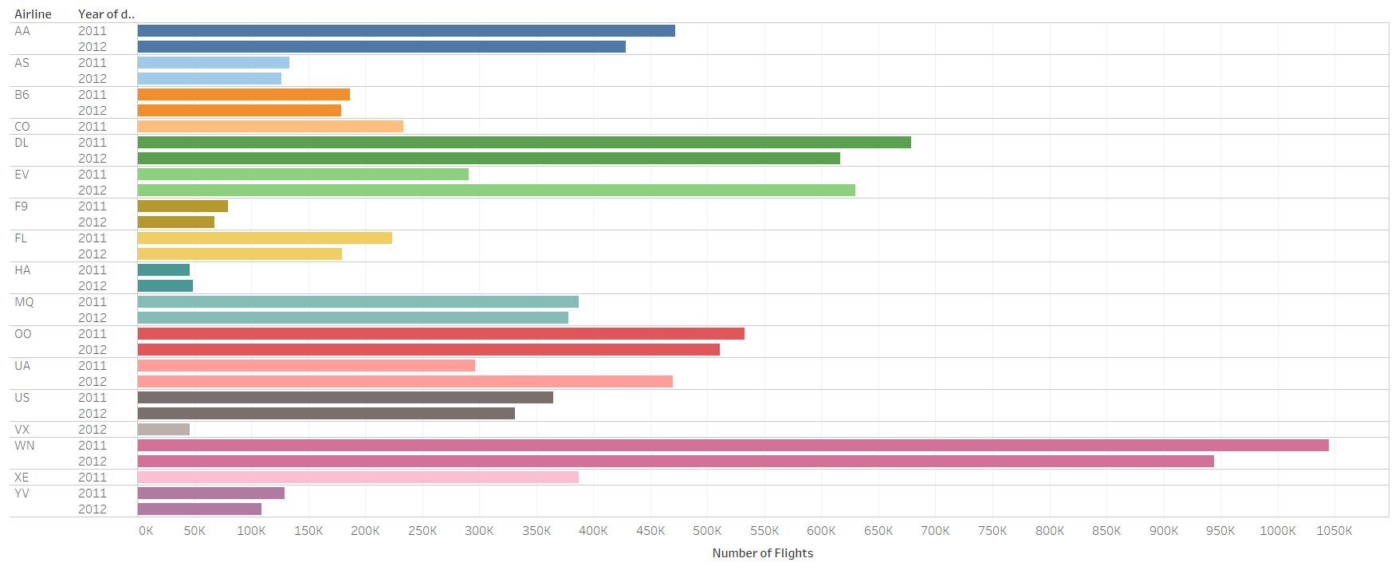
How many flights did each carrier carried out from 2011 to 2012

Slide 7
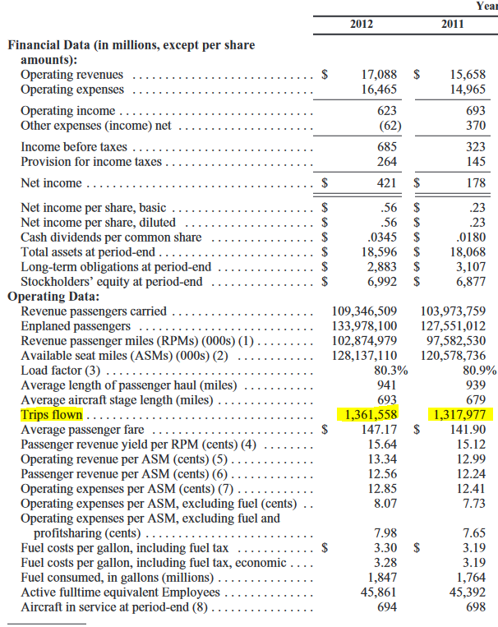
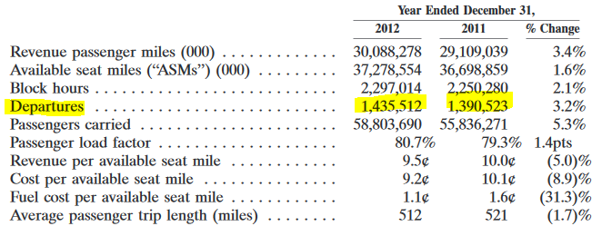
Bevinding

Slide 8
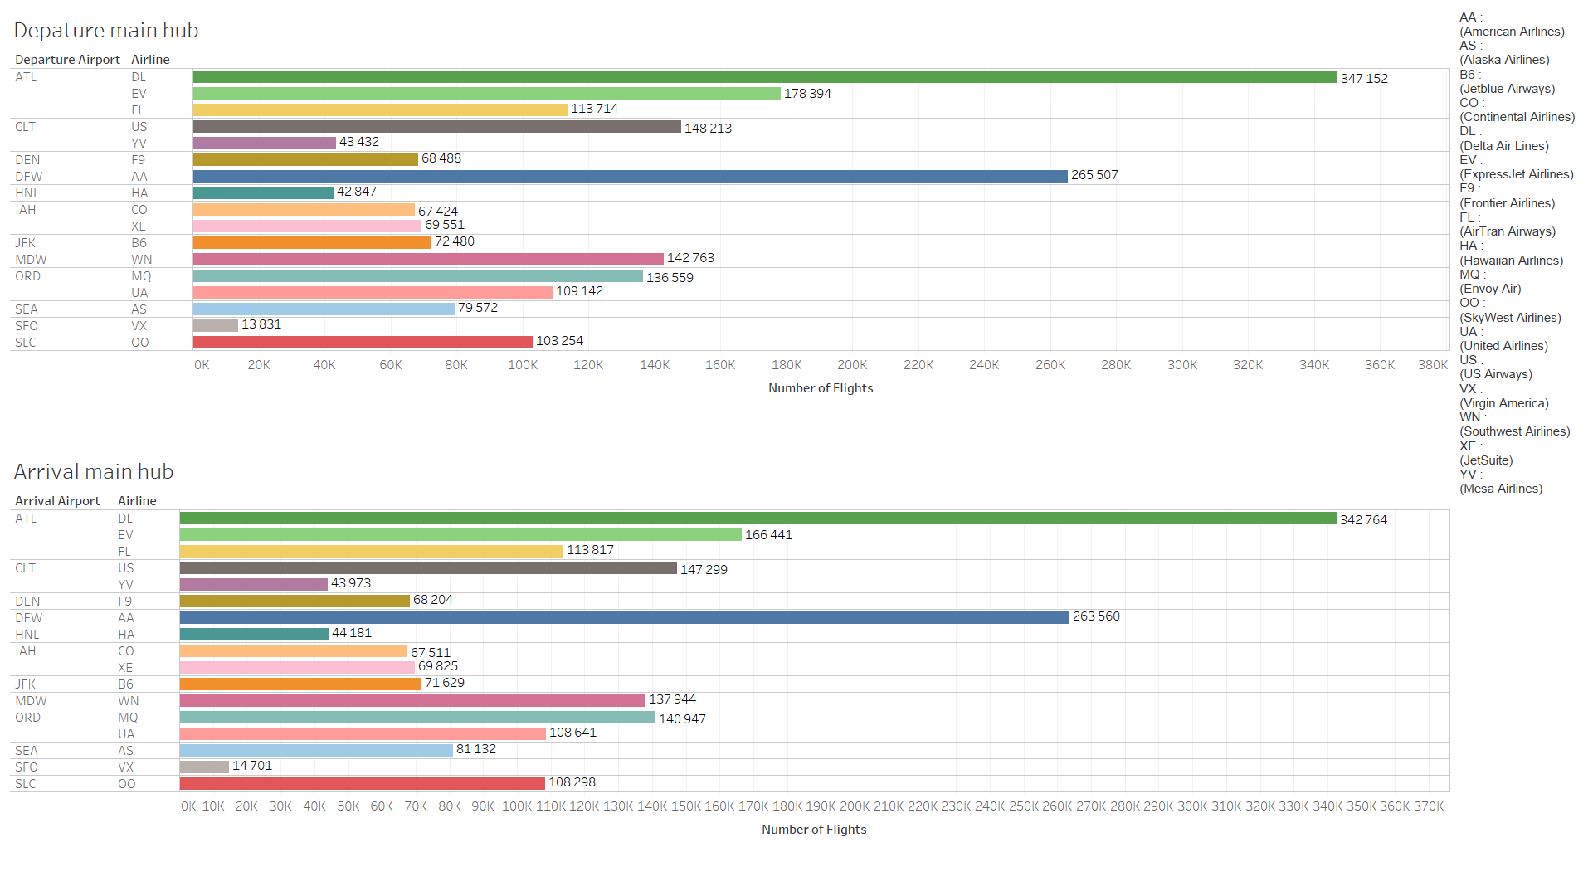
What are the hubs for each carrier?

Slide 9
Bevindingen
Vliegtuig Maatschappij | Hubs van de grafiek | Main-hub
American Airlines (AA) | DFW | DFW
Alaska Airlines (AS) | SEA | SEA
Jetblue Airways (B6) | JFK | JFK
Continental Airlines (CO) | IAH | IAH
Delta Airlines (DL) | ALT | ALT
ExpressJet Airlines (EV) | ALT | IAH
Frontier Airlines (F9) | DEN | DEN
AirTran Airways (FL) | ALT | ATL
Hawaiian Airlines (HA) | HNL | HNL
Envoy Air (MQ) | ORD | DFW
SkyWest Airlines (OO) | SLC | LAX
United Airlines (UA) | ORD | ORD
US Airways (US) | CLT | CLT
Virgin America (VX) | SFO | SFO
Southwest Airlines (WN) | MDW | MDW
JetSuite (XE) | IAH | IAH
Mesa Airlines (YV) | CLT | PHX

Slide 10
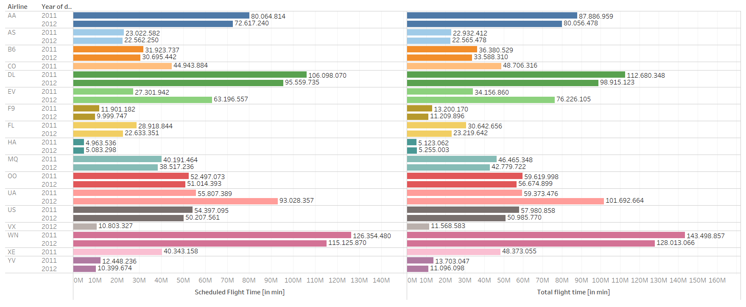
The total amount of scheduled flight time compared to the actual flight time per carrier from 2011 to 2012

Slide 11
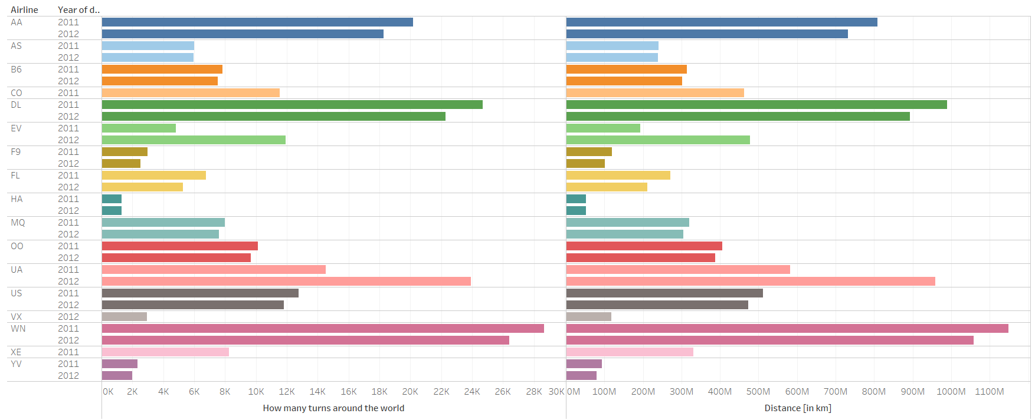
How many turns around the world could you travel from the total flown km per carrier from 2011 to 2012

Slide 12
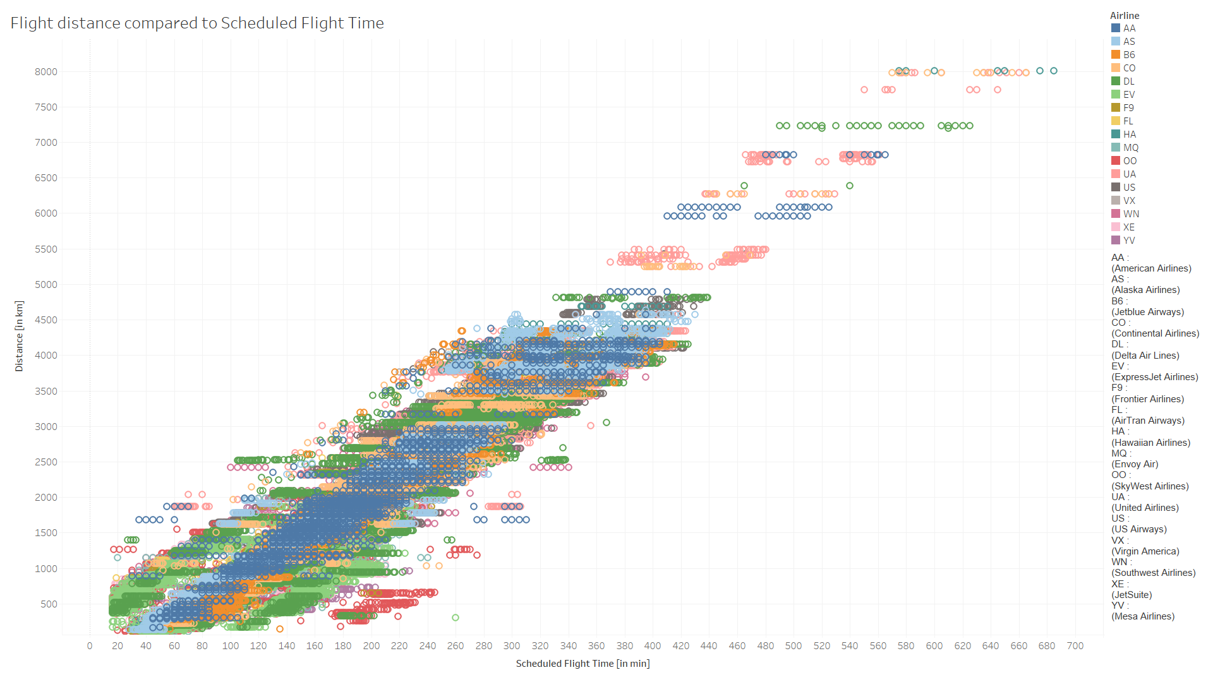
The fight distance compared to the scheduled flight time per carrier

Slide 13
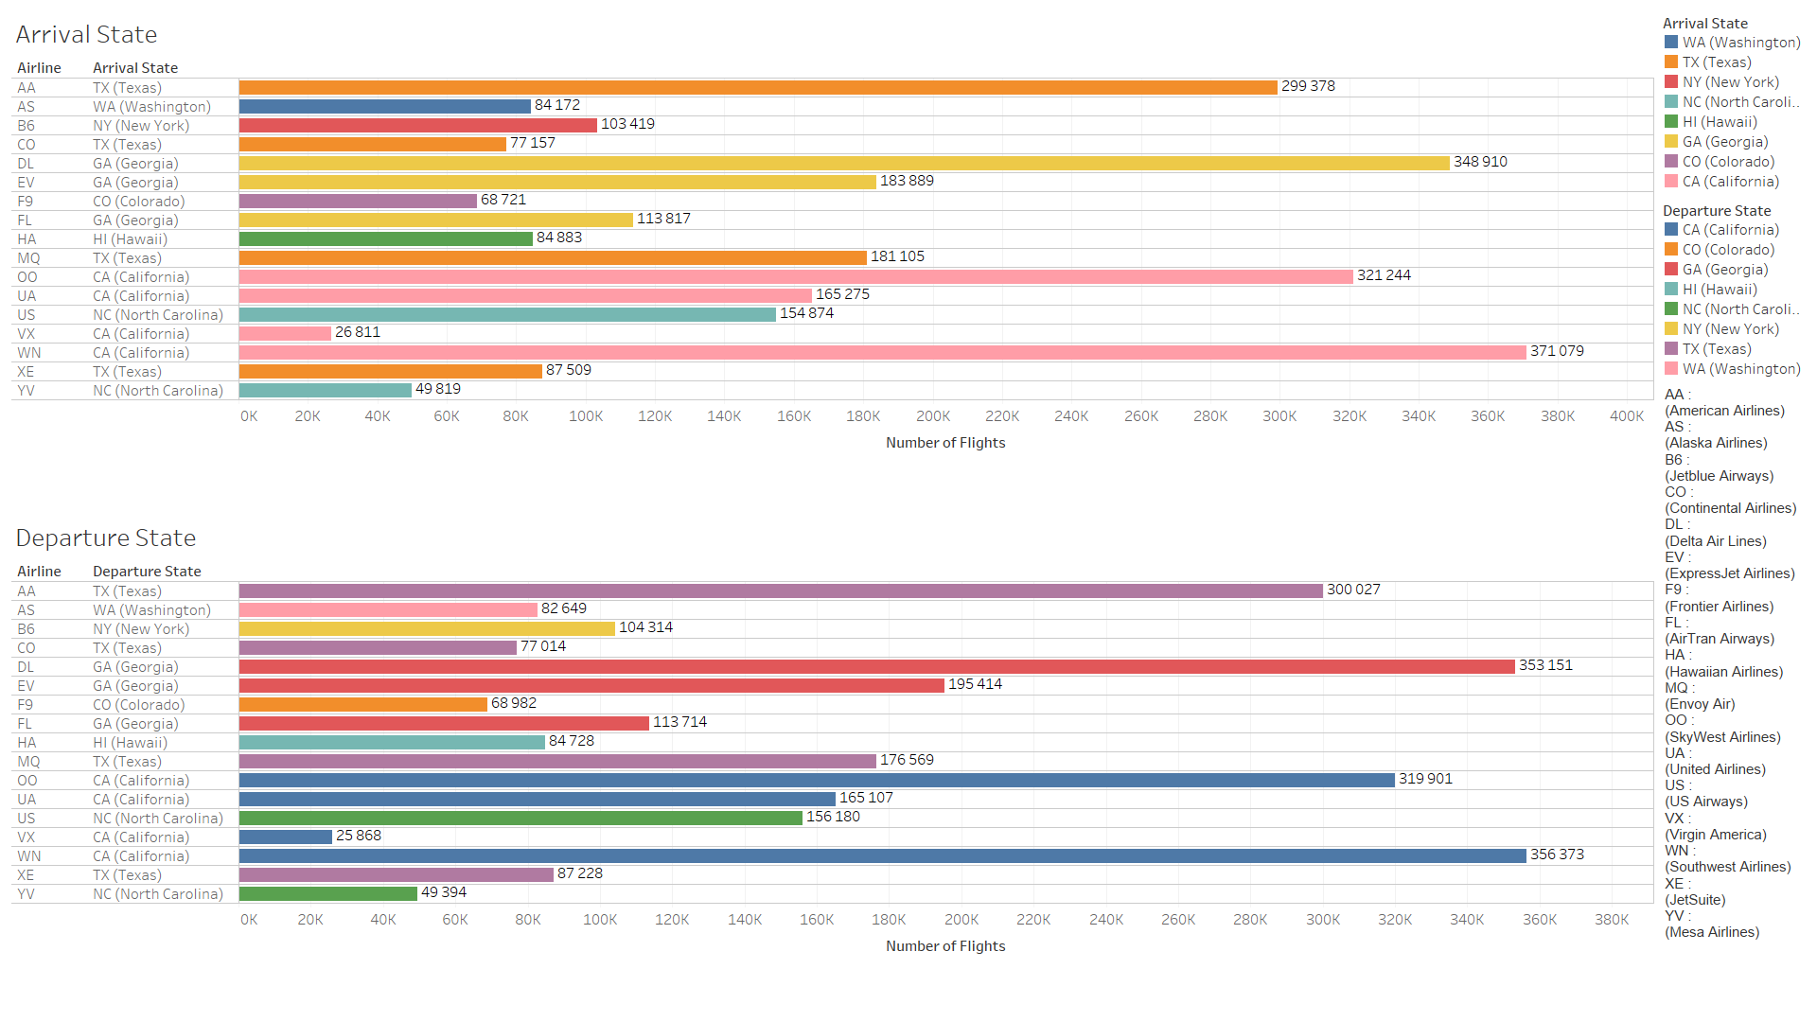
Per carrier what are the most popular departure states and arrival states

Slide 14
Bevindingen
Vliegtuig Maatschappij | Vertrokken vluchten | Gelande vluchten
American Airlines (AA) | 300 027 | 299 378
Alaska Airlines (AS) | 82 649 | 84 172
Jetblue Airways (B6) | 104 314 | 103 419
Continental Airlines (CO) | 77 014 | 77 157
Delta Airlines (DL) | 353 151 | 348 910
ExpressJet Airlines (EV) | 195 414 | 183 889
Frontier Airlines (F9) | 68 982 | 68 721
AirTran Airways (FL) | 113 714 | 113 817
Hawaiian Airlines (HA) | 84 728 | 84 883
Envoy Air (MQ) | 176 569 | 181 105
SkyWest Airlines (OO) | 319 901 | 321 244
United Airlines (UA) | 165 107 | 165 275
US Airways (US) | 156 180 | 154 874
Virgin America (VX) | 25 868 | 26 811
Southwest Airlines (WN) | 356 373 | 371 079
JetSuite (XE) | 87 288 | 87 509
Mesa Airlines (YV) | 49 394 | 49 819

Slide 15
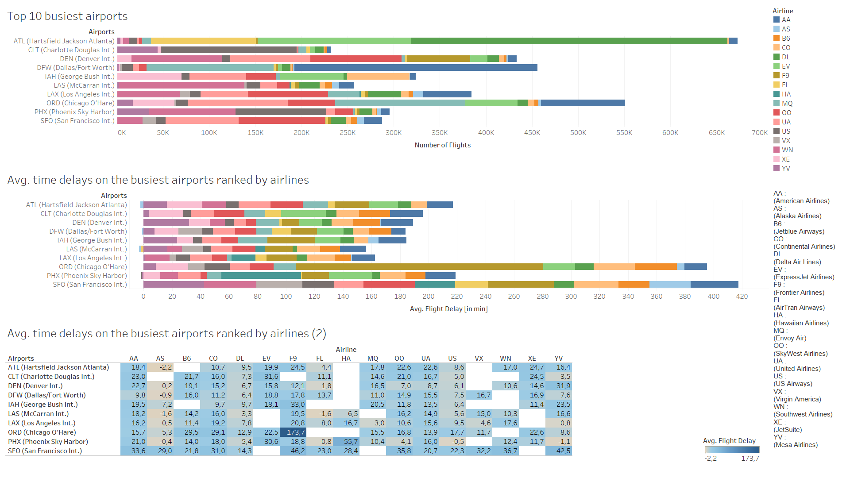
What are top 10 busiest airports and their average time delays

Slide 16
What are top 10 busiest airports and their average time delays

Slide 17
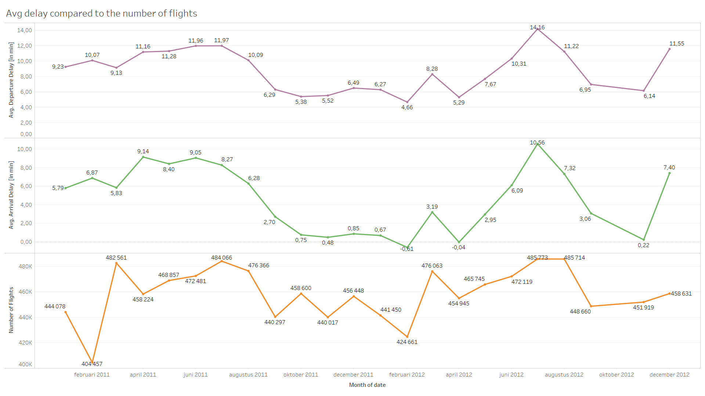
The average departure delay and the average arrival delay compared to the number of flights per month

Slide 18
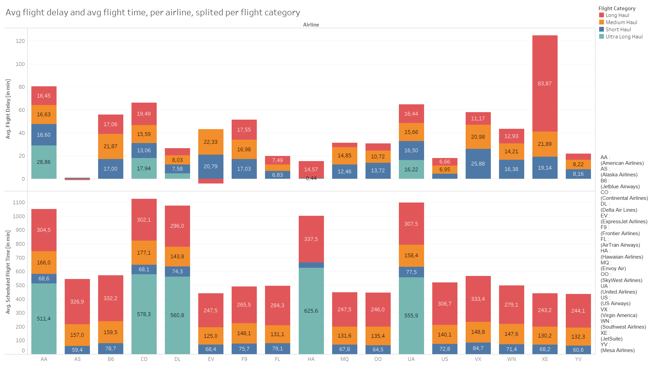
The average flight time and average delay per flight category compared with each carrier

Slide 19

Machine learning

Slide 20
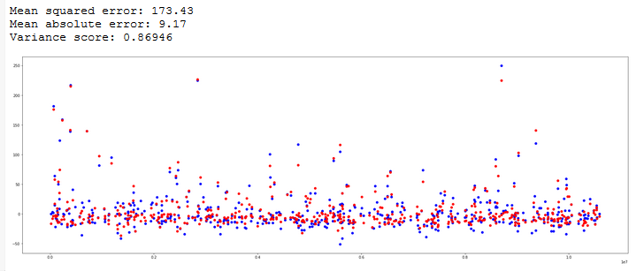
Random Forest Regressor model

Slide 21
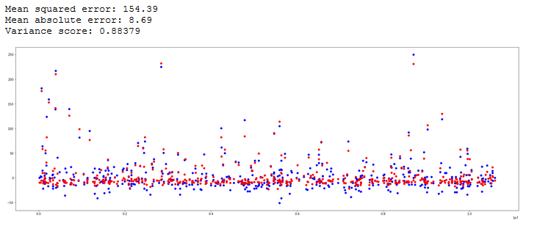
Lineair Regression model

Slide 22
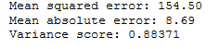
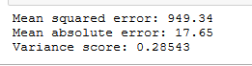
Ridge Regression model
Lasso Regression model

Slide 23
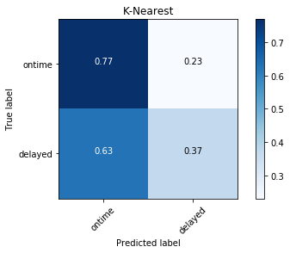
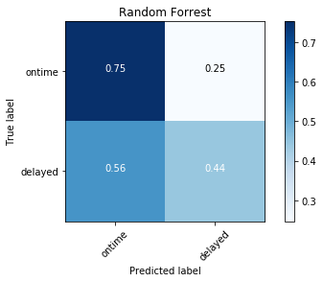
Random Forrest Classifier
K-Nearest Neighbors Classifier

Slide 24

NetworkX

Slide 25
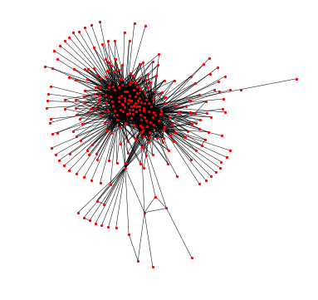
Grafiek van alle luchthavens en hun routes

Slide 26
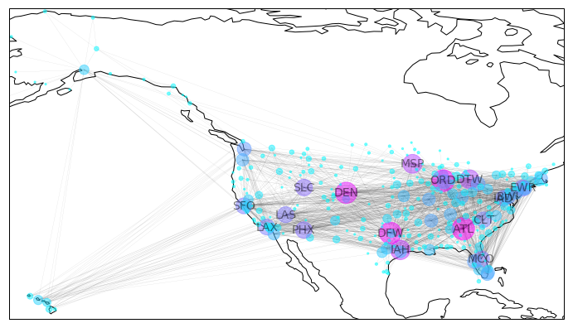
Route map

Slide 27

Bedankt Zijn er nog vragen?

